Slide 1
Introduction to sequencing data analysis
Elisa Donnard, PhD
UMassMed Biocore Bootcamp 2021
Notes:
The goal of this course is to make you familiar with genome-wide sequencing approaches and the computational analyses that are essential to them.
Some of you may have an immediate application in mind or already have collected a particular type of data,
so you can think of the possible new ways to analyze it,
and for those who do not have an immediate application in mind,
you can get started in genomics and plan your collection and analysis, and maybe think of how to explore the massive amount of data already available.

Slide 2
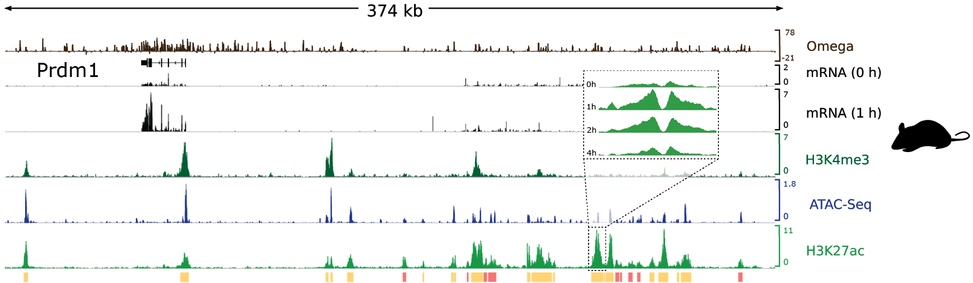
Genome-scale data
Garber lab, 2018 Cell Systems
Notes:
Before we go into the technical part, I want to briefly motivate everyone and give a brief overview of the power of these approaches to survey the transcriptional and chromatin landscape of a cell or tissue.
In this picture, I am showing you a common visualization for genomic data, coverage profiles in a genome browser.
This is spanning over 300kb of the mouse genome, and you can see the Prdm1 gene represented at the top left.
Below the gene shown in black are two different tracks for RNA-Seq, you can notice that the peaks for these tracks correspond to the exon regions of the gene,
expected from the higher contribution of mature (spliced) mRNA to the libraries sequenced. Notice also that there is not much signal outside of the gene locus.
We can also generate libraries to survey chromatin accessibility, shown in blue from ATAC-seq, and histone modifications using ChIP-Seq, such as H3K27ac (light green) and H3K4me3 (dark green).
These data allow us to detect regions that likely function as regulatory elements, including promoters and enhancers.
With this picture I also want to point out that there is also more power to these studies when done in combination,
since integrating all of this information can help us understand more than we would by examining them separately.
And to introduce one final dimension, we can also collect this information in a time course, to follow cellular processes.

Slide 3
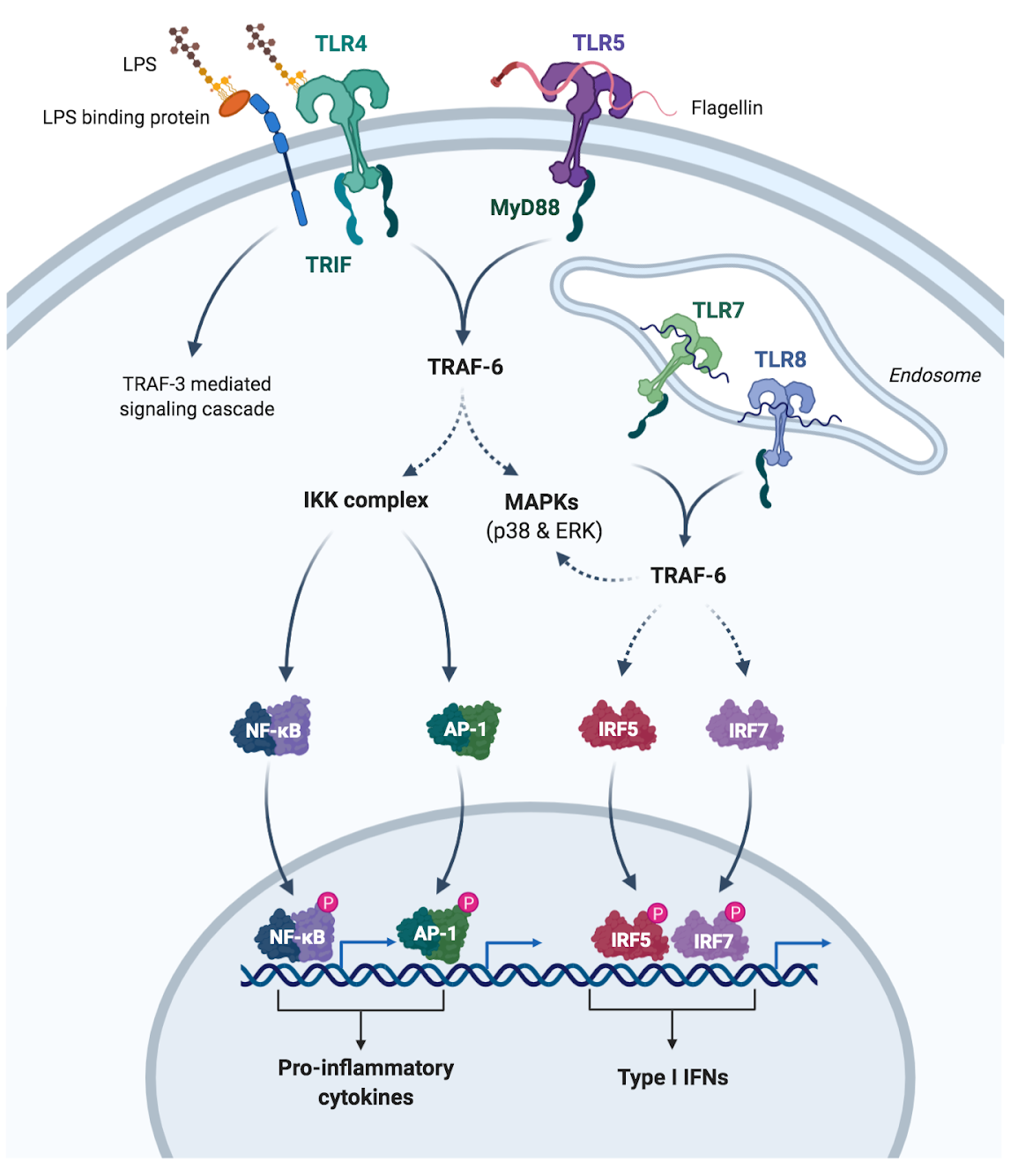
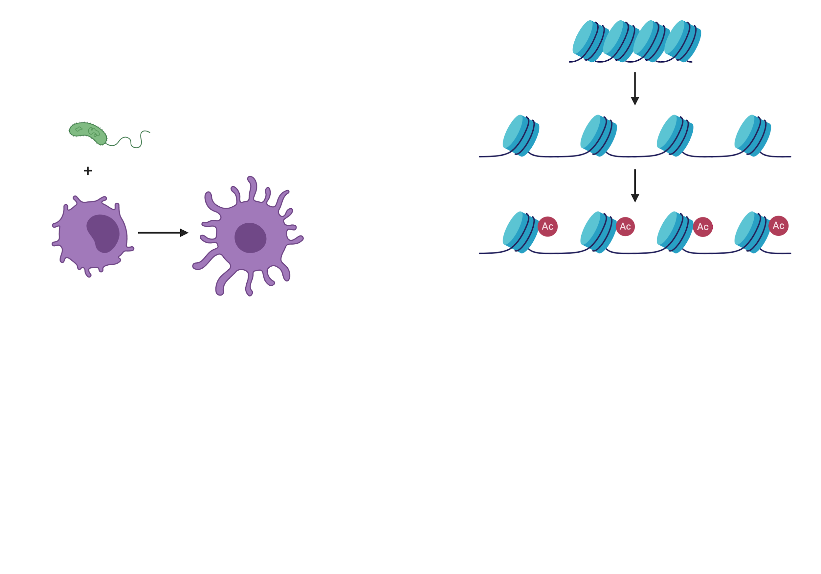
Readout of a cell state
Notes:
The way we like to think about this type of data is as a readout of a cell state.
Cells respond to changes in their environment, and we can observe the impact of these changes in their transcription output or chromatin landscape.
One of the favorite systems we use in the Garber lab, because of how dramatic the difference is, are dendritic cells, which are part of your innate immune system, when they come in contact with LPS, a molecule present in the membrane of gram negative bacteria.
Cells use signaling cascades to process this kind of information from their environment. This is an example of a typical cascade involving an extracellular receptor (TLR4) that triggers a transcriptional response.

Slide 4
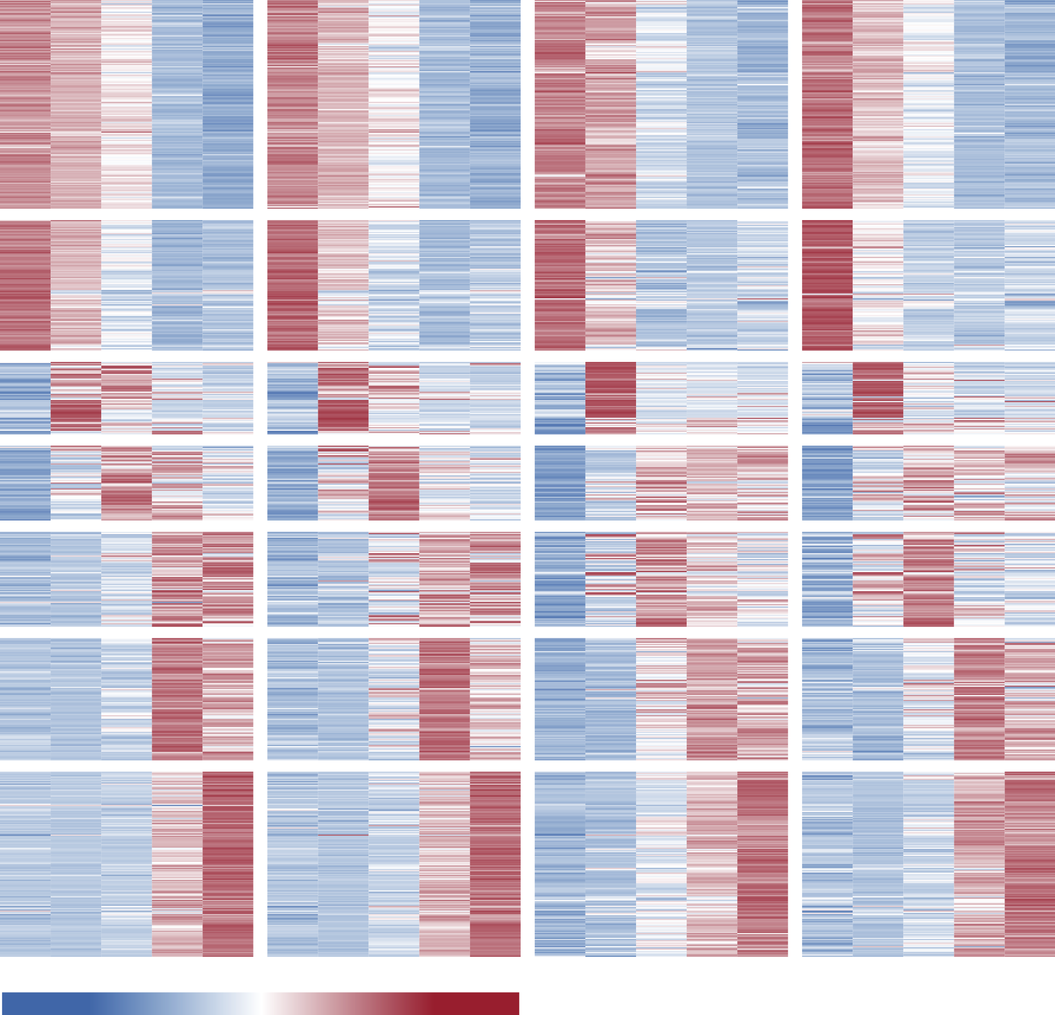



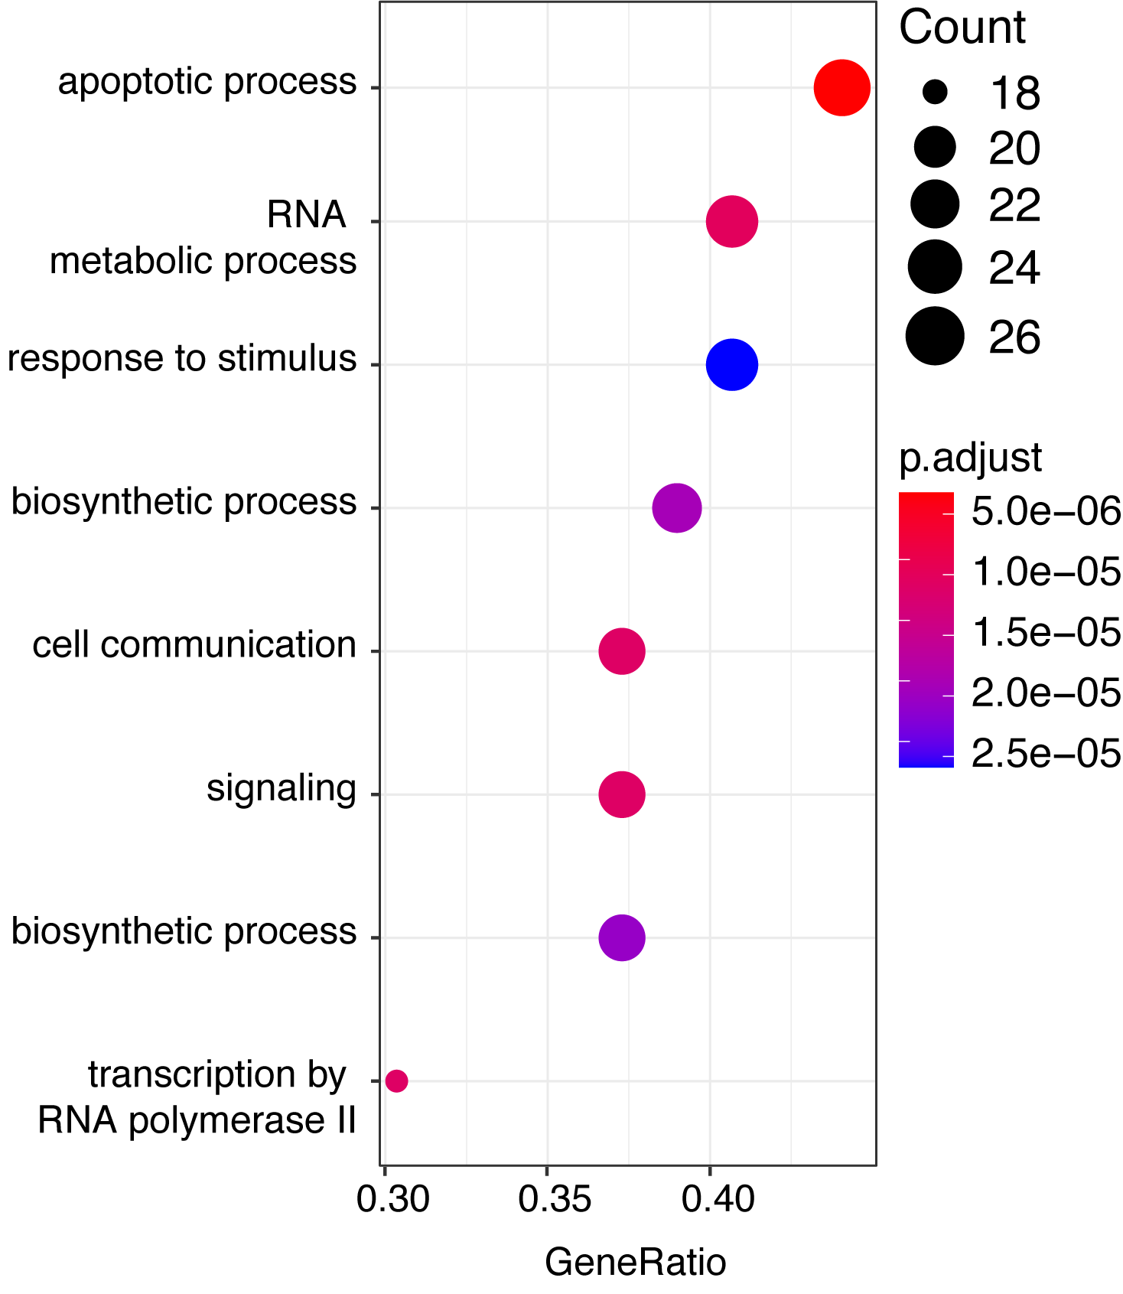
RNA-Seq
Replicate 1
Replicate 2
Differential expression
286 genes
141 genes
259 genes
Expression
0h
1h
2h
4h
6h
0h
1h
2h
4h
6h
low
high
LPS stimulation time
Garber lab
Notes:
This transcriptional response is dramatic as I mentioned, there are roughly 2000 genes upregulated and another 2000 downregulated, I am showing you only part of them in this heatmap.
The heatmap if you are not familiar, is a way to display the expression of a large number of genes, in multiple conditions and replicates, here I am showing you the expression of genes in dendritic cells from two different human donors, collected at several time points before and after they were stimulated with LPS.
The red color marks higher expression for a given gene, and blue marks lower expression.
You can see many genes show similar patterns of expression, and the reason this is easy to detect is that this heatmap has been plotted after clustering genes with similar expression across time.
We can focus on a specific cluster showing the same response, for example genes that are rapidly induced and show maximum expression at 1h post LPS stimulation.
And we can use Gene Ontology enrichment analysis to explore the function of these genes, and we find that there are specific cellular processes enriched here, such as RNA metabolism, cell communication or transcription, which all make sense in a cell that is undergoing such a drastic transcriptional response.

Slide 5
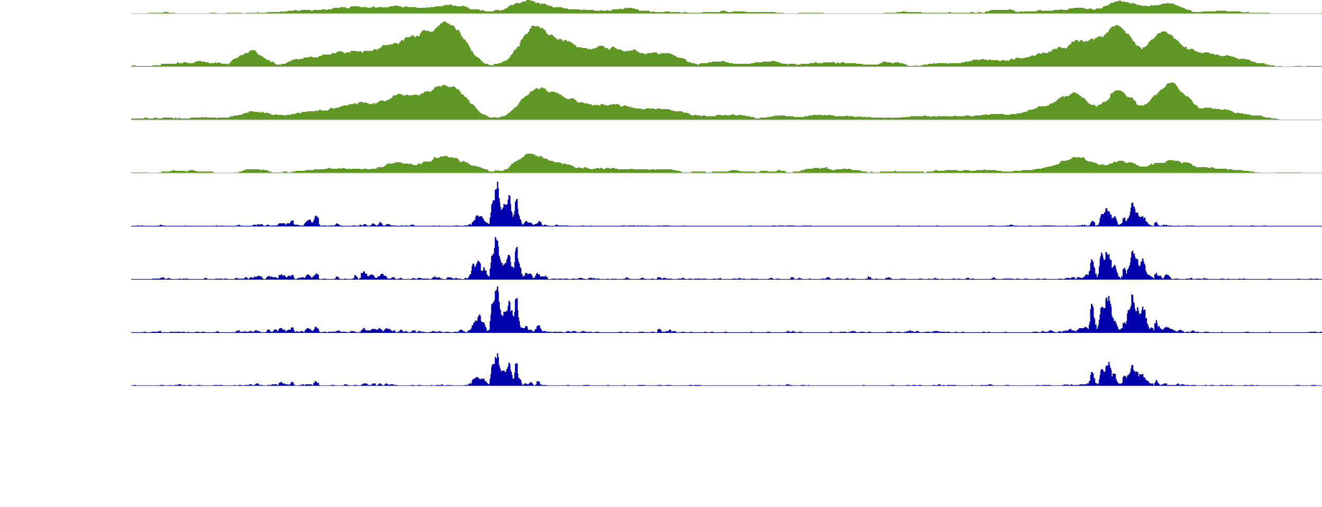
Chromatin profiling
Increased accessibility (ATAC-Seq)
Increased acetylation (ChIP-Seq)
0h
1h
2h
4h
0h
1h
2h
4h
Garber lab
Notes:
Many changes are also happening at the chromatin level in these cells, and we can detect them using assays such as
ATAC-seq, which detects regions where the chromatin is more accessible,
or ChIP-Seq, which we can use to survey modifications in histones such as acetylation,
which is very correlated to transcriptional activity and present in the regulatory elements regulating these genes.
You can see for this particular enhancer, there is no change in accessibility after the LPS stimulation of these cells, but the levels of H3K27ac increase substantially, similar to the transcriptional levels of the gene it regulates.

Slide 6
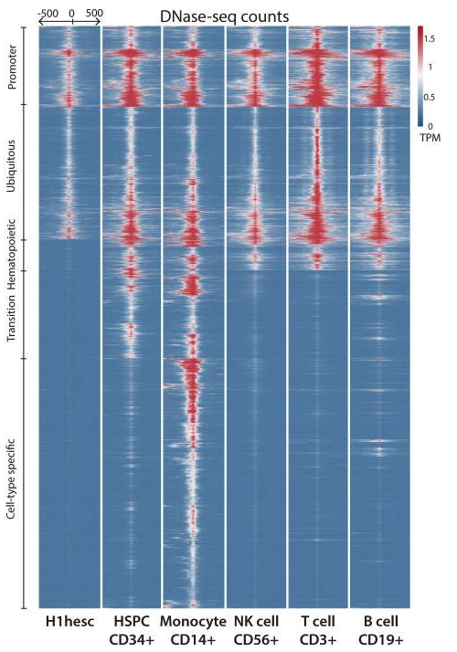
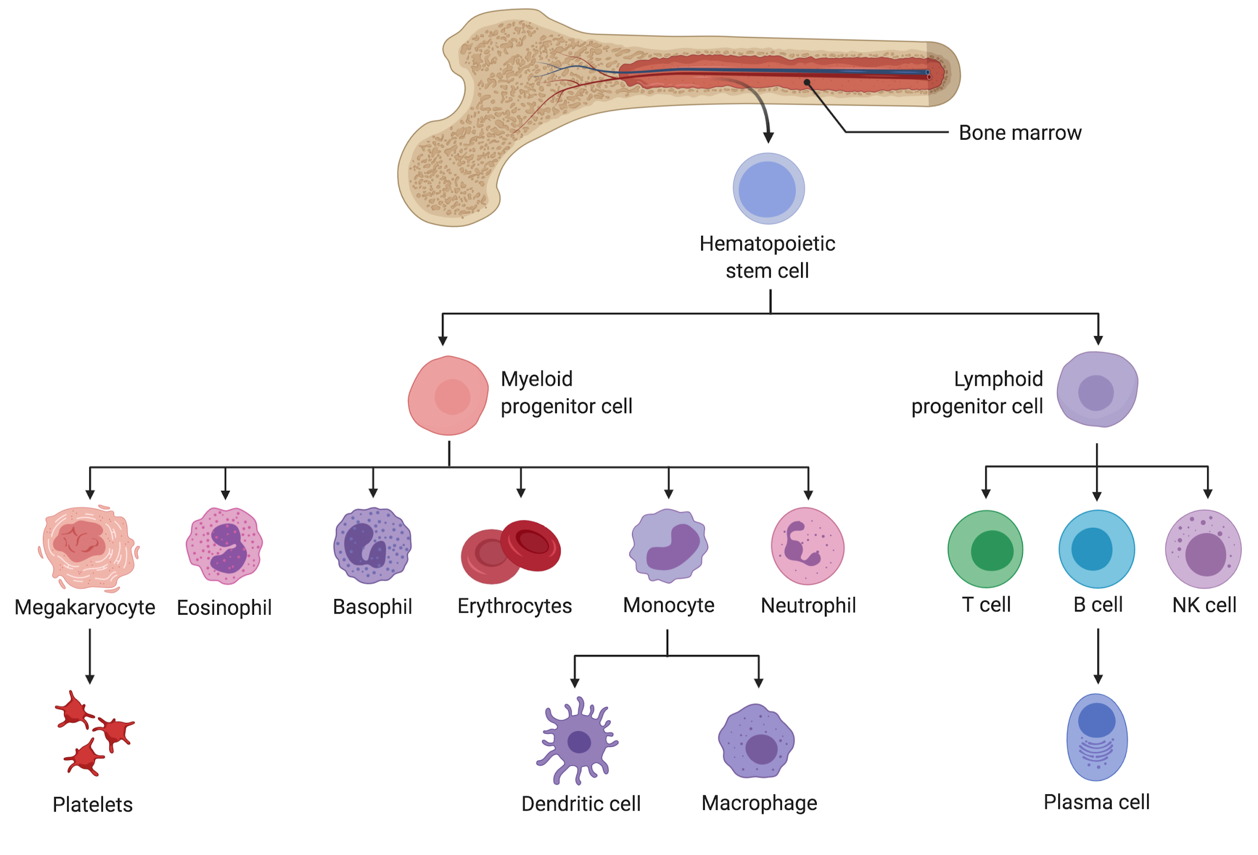
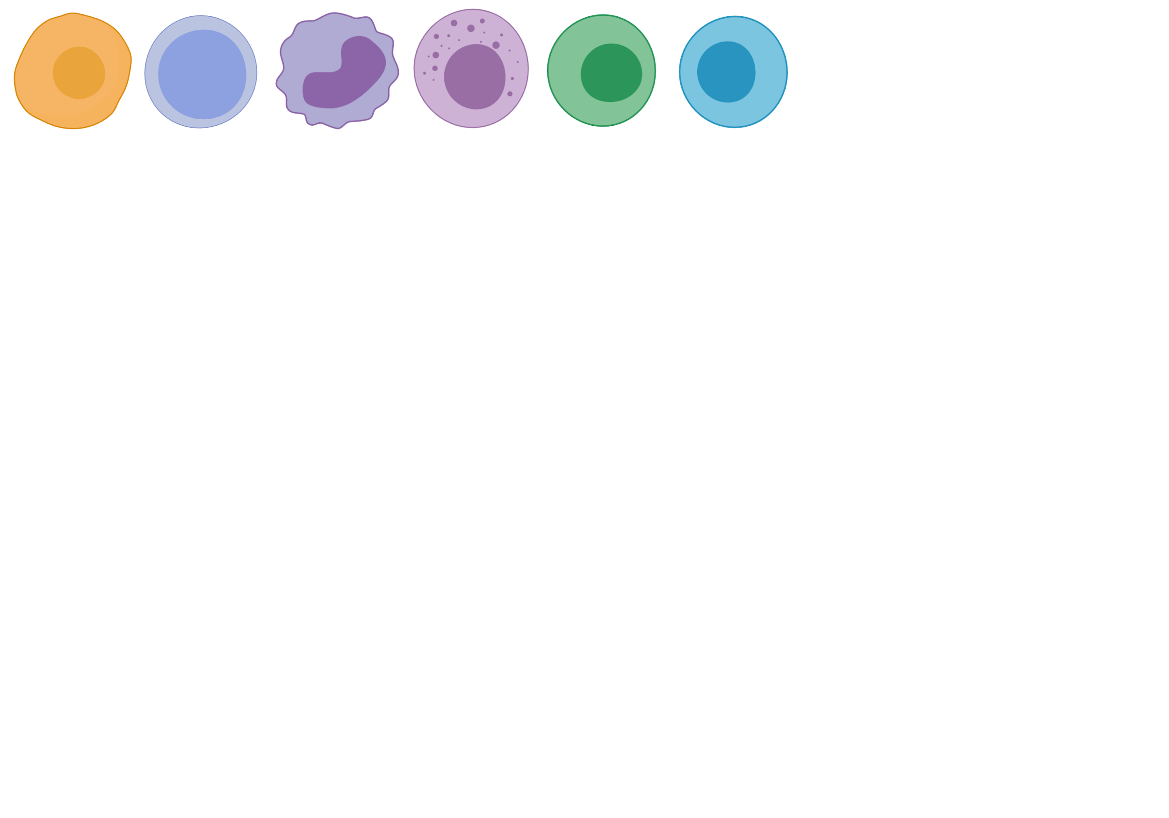
Differentiation
Accessibility (DNase-Seq)
Gonzáles et al. 2015
Notes:
Another common application is to examine changes that happen during differentiation, for example shown here is the hematopoietic cell lineage.
A beautiful study by Christina Leslie’s group showed the regulatory elements that are common to all these cells and established since their progenitors,
And also which elements are cell-type specific. The regulatory elements were identified by DNase-Seq, which is another technique that captures chromatin accessibility.

Slide 7
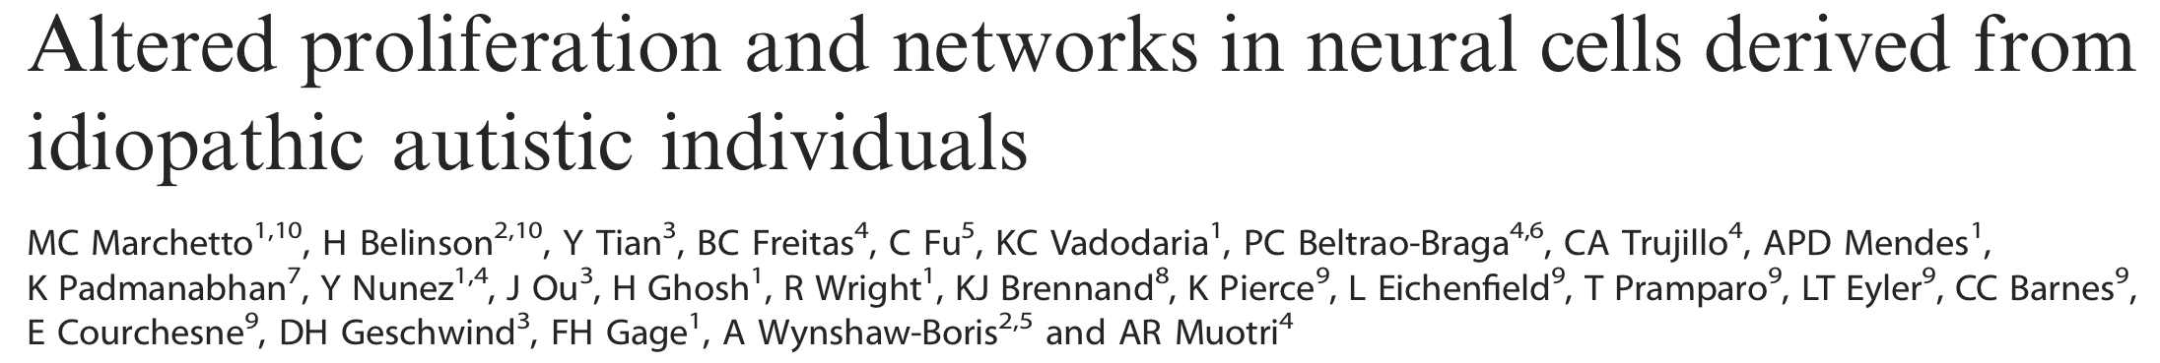
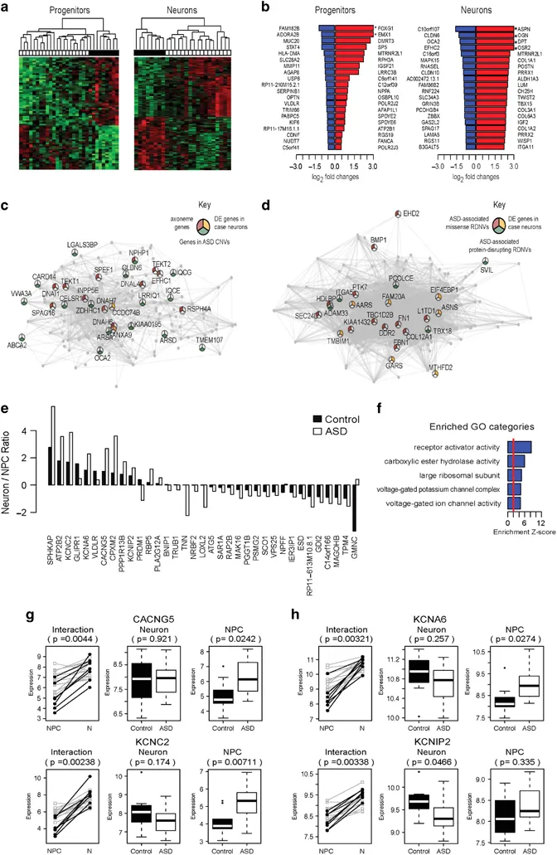
Gene expression profiles in disease
Autism x Control
Notes:
Many other examples of applications, this one from a couple of years ago:
RNA-Seq from NPCs and Neurons derived from human iPSCs from autistic or control individuals,
Progenitor cells from autistic individuals show differences in proliferation and development, and this is captured in their transcriptome profiles
The study unraveled biologically relevant pathway disruptions and showed also genes with dynamic changes of expression through neuron development, enriched in pathways (f) that link voltage-gated cation channel dysregulation in ASD neural differentiation, consistent with decreased excitatory glutamatergic synapses, likely affecting synaptic transmission.
Many other applications, drug response, genotype profiling, KO studies, etc.

Slide 8
How do we get there?
Data analysis steps

Slide 9
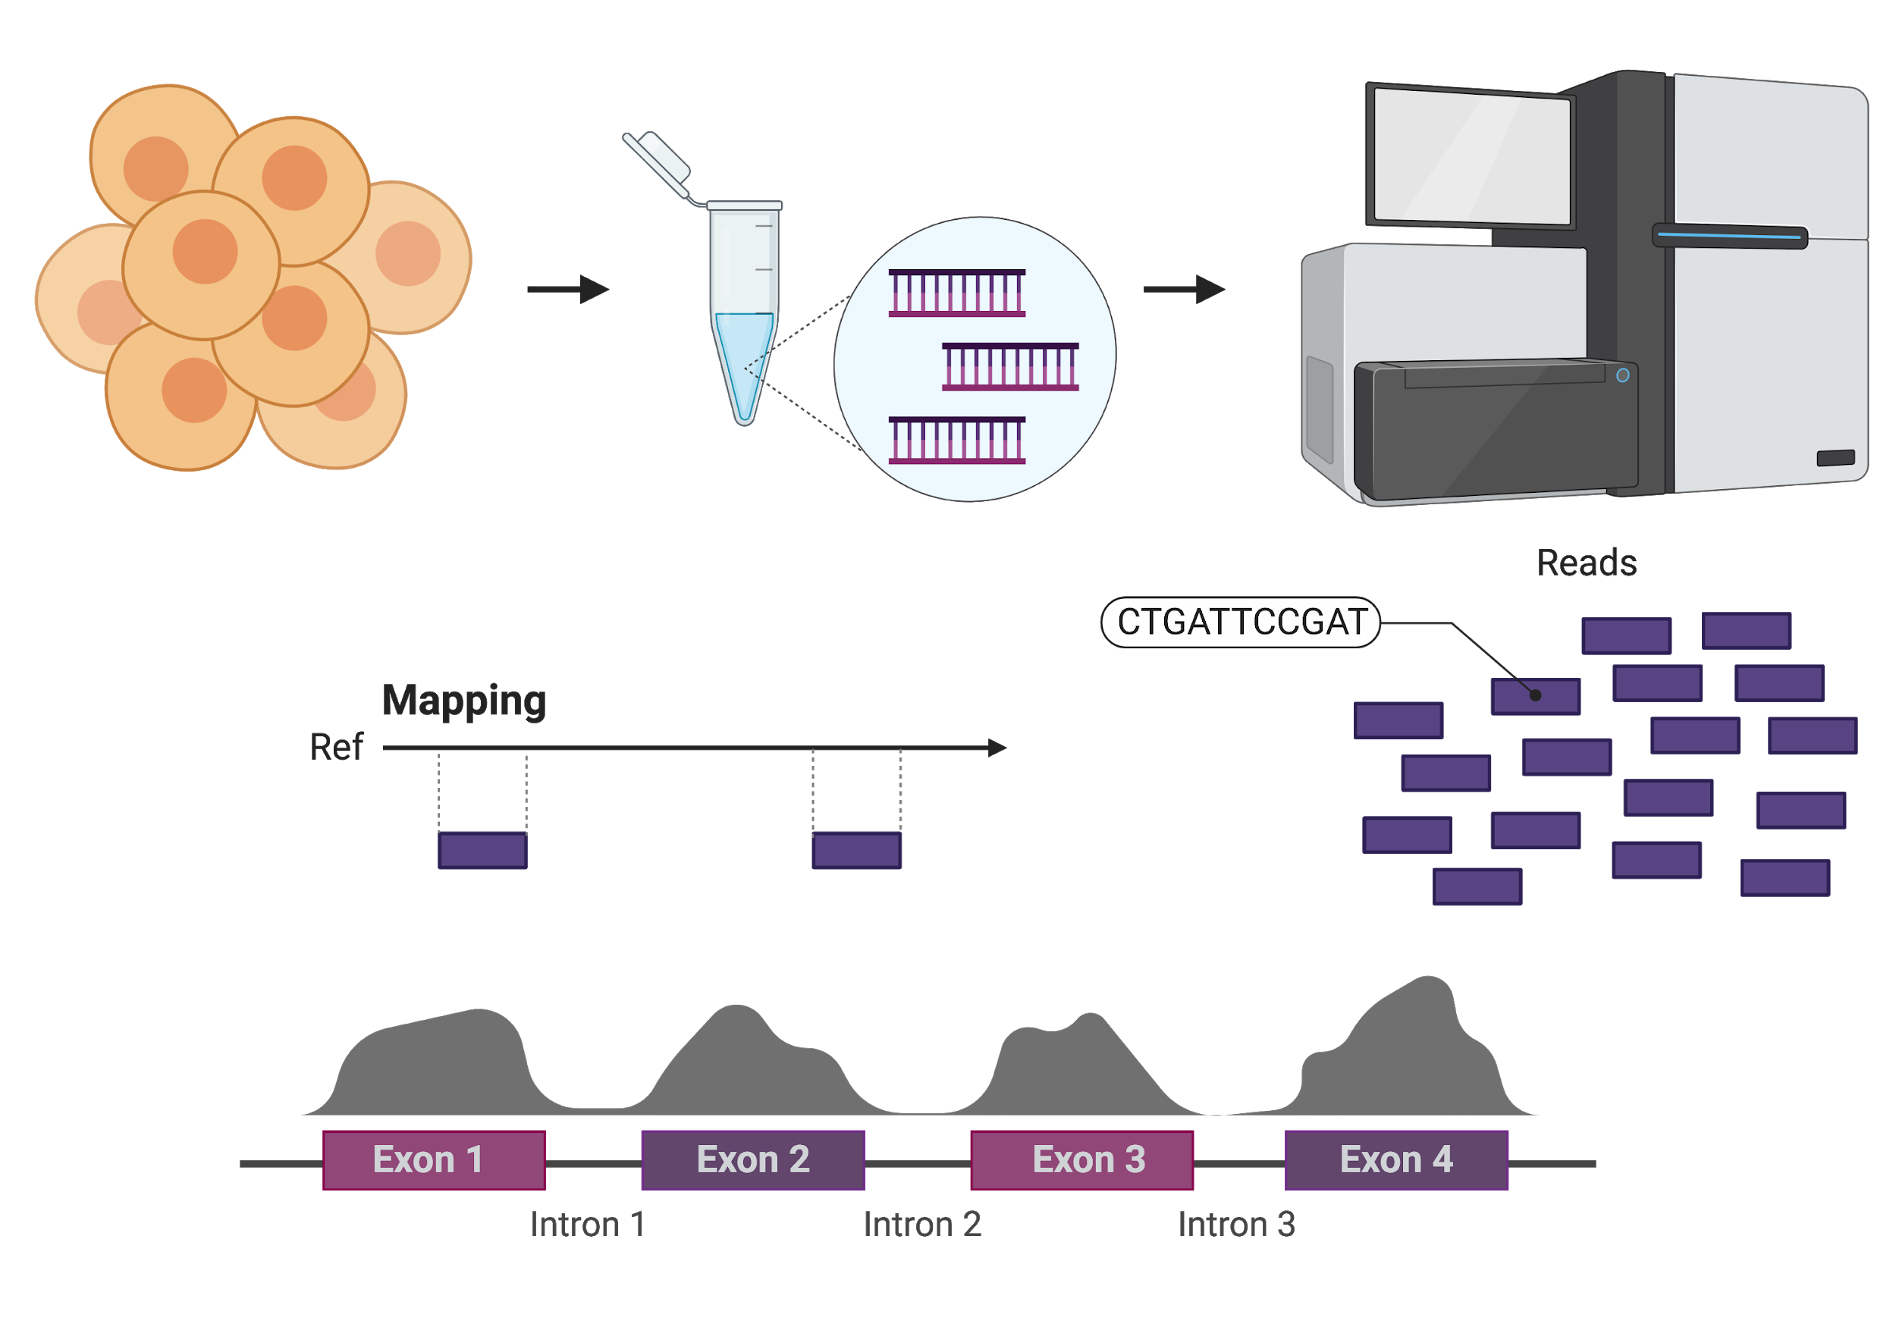
cells
DNA or cDNA
sequencing
Read coverage
Notes:
Let’s go through a quick overview of what needs to happen.
You have some cells of interest, from which you made a library of DNA or cDNA fragments, and loaded this on a sequencer. All of this is happening physically in the lab.
After the sequencing run, your output are reads, which are contained in files in your computer, and we need to figure out where in the genome they came from. After this mapping or alignment, we can generate read coverage profiles and start to interpret this information.
We will go through all these computational steps in more detail, including all of the analyses I mentioned for RNA-Seq. But the basis is the same for genomic data as well.

Slide 10
References
Donnard E, Vangala P, Afik S, et al. Comparative Analysis of Immune Cells Reveals a Conserved Regulatory Lexicon. Cell Syst. 2018;6(3):381–394.e7. doi:10.1016/j.cels.2018.01.002
González AJ, Setty M, Leslie CS. Early enhancer establishment and regulatory locus complexity shape transcriptional programs in hematopoietic differentiation. Nat Genet. 2015;47(11):1249–1259. doi:10.1038/ng.3402
Marchetto, M., Belinson, H., Tian, Y. et al. Altered proliferation and networks in neural cells derived from idiopathic autistic individuals. Mol Psychiatry 22, 820–835 (2017). doi:10.1038/mp.2016.95
Manuel Garber and all Garber lab members
Cartoons: biorender.com

